Slide 1

Correcting batch effect on an integrated transcriptional atlas.
Yidi Deng
Supervised by: Kim-Anh le Cao, Jarny Choi, Paul Angel

Slide 2
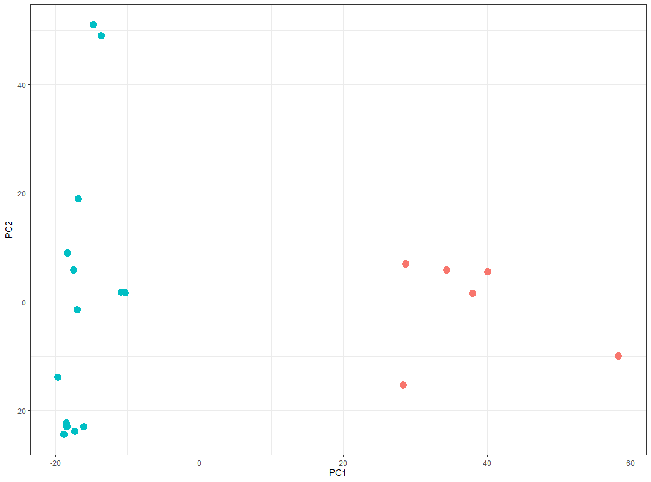
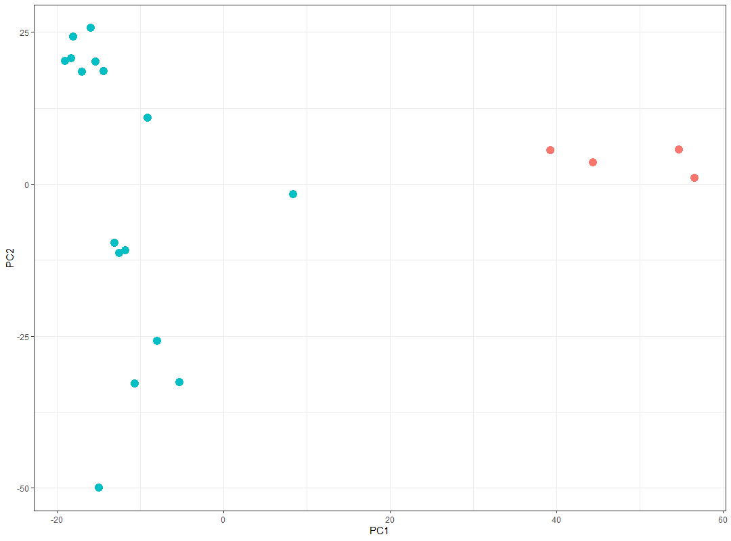
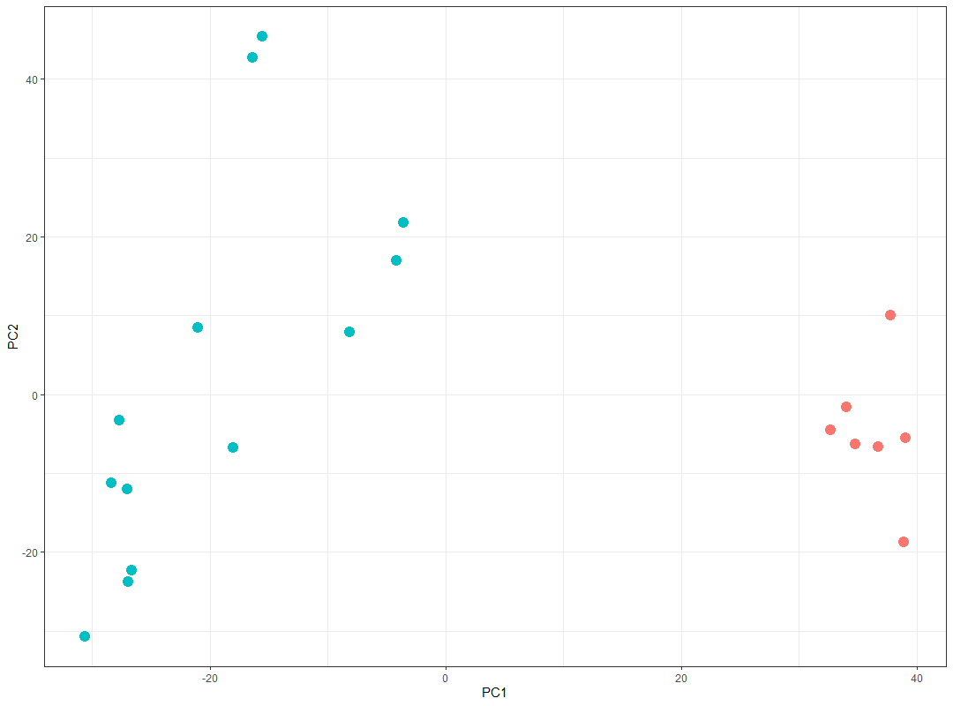
Building an integrated human myeloid transcriptional atlas
 | Samples (907)
genes (3607) | RNA-seq raw counts
 | Samples (907)
genes (3607) | 44 different studies 22 different cell types 3 different culture environments (in-vivo, in-vitro, ex-vivo) 3 progenitor types (pluripotent stem cell, hematopoietic progenitor cell, myeloid)
It is complied with transcriptomic data of

Slide 3
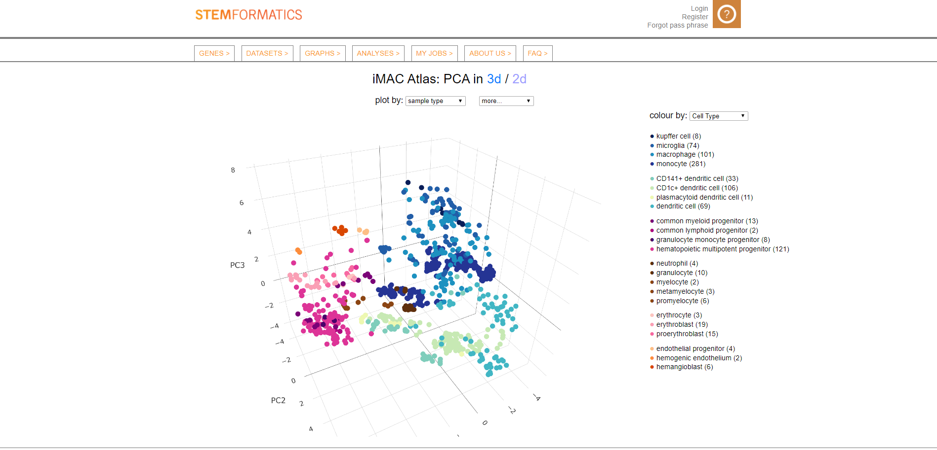
iMac atlas (Available on https://www.stemformatics.org/atlas)
What is iMac?
A reference transcriptional atlas that can be bench marked against human myeloid biology
It’s like a map on which you can see the location of a cell (IN THE EXPRESSIONAL SPACE)

Slide 4
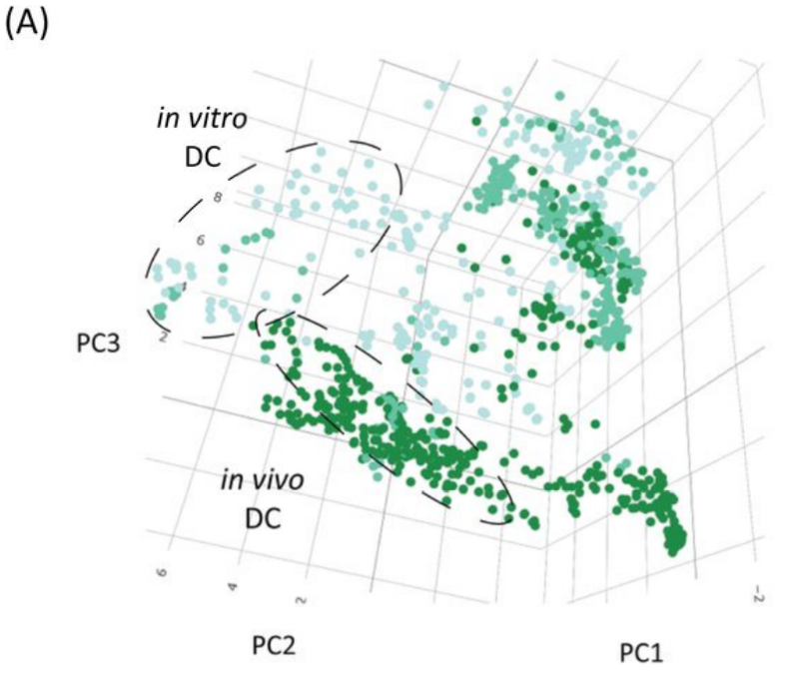
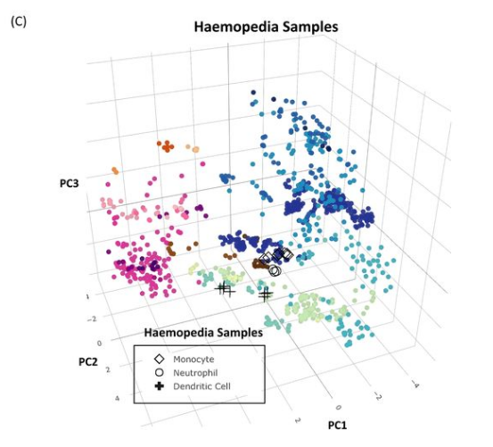
What you can do with iMac?
Hypothesis visualization.
i.e. Reviling human myeloid cell culture phenotype
Hypothesis generation
i.e. Project you own data onto iMac and see where it goes.

Slide 5
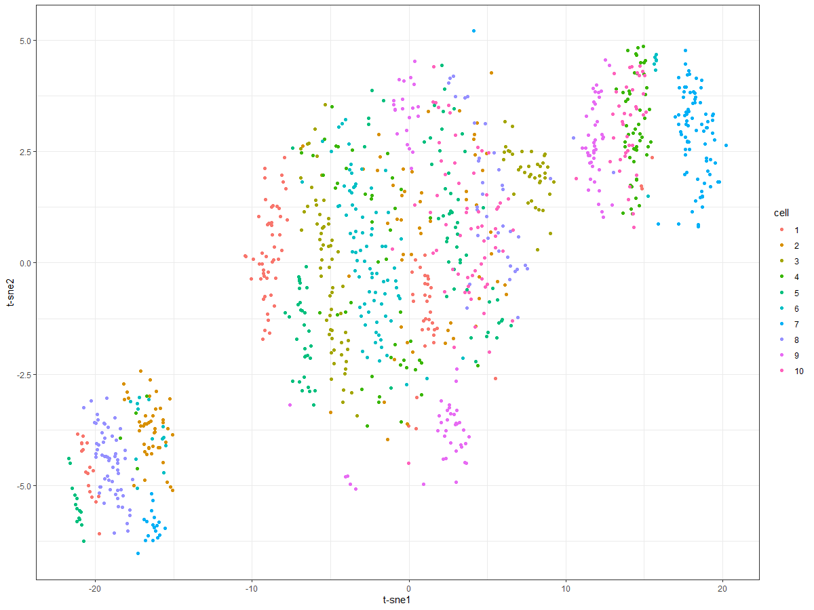
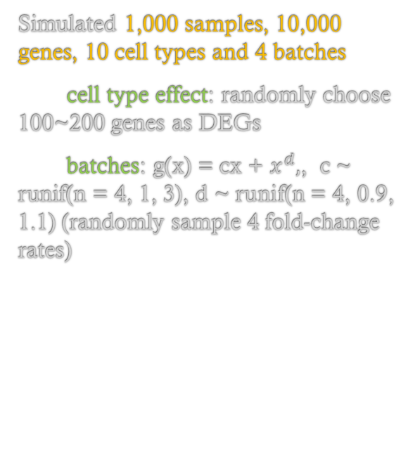
batch effect
uncorrected
Batch 2
Batch 4
Simulated 1,000 samples, 10,000 genes, 10 cell types and 4 batches
cell type effect: randomly choose 100~200 genes as DEGs
batches: g(x) = cx + $x^{d},$, c ~ runif(n = 4, 1, 3), d ~ runif(n = 4, 0.9, 1.1) (randomly sample 4 fold-change rates)
Batch 1
Batch 3

Slide 6
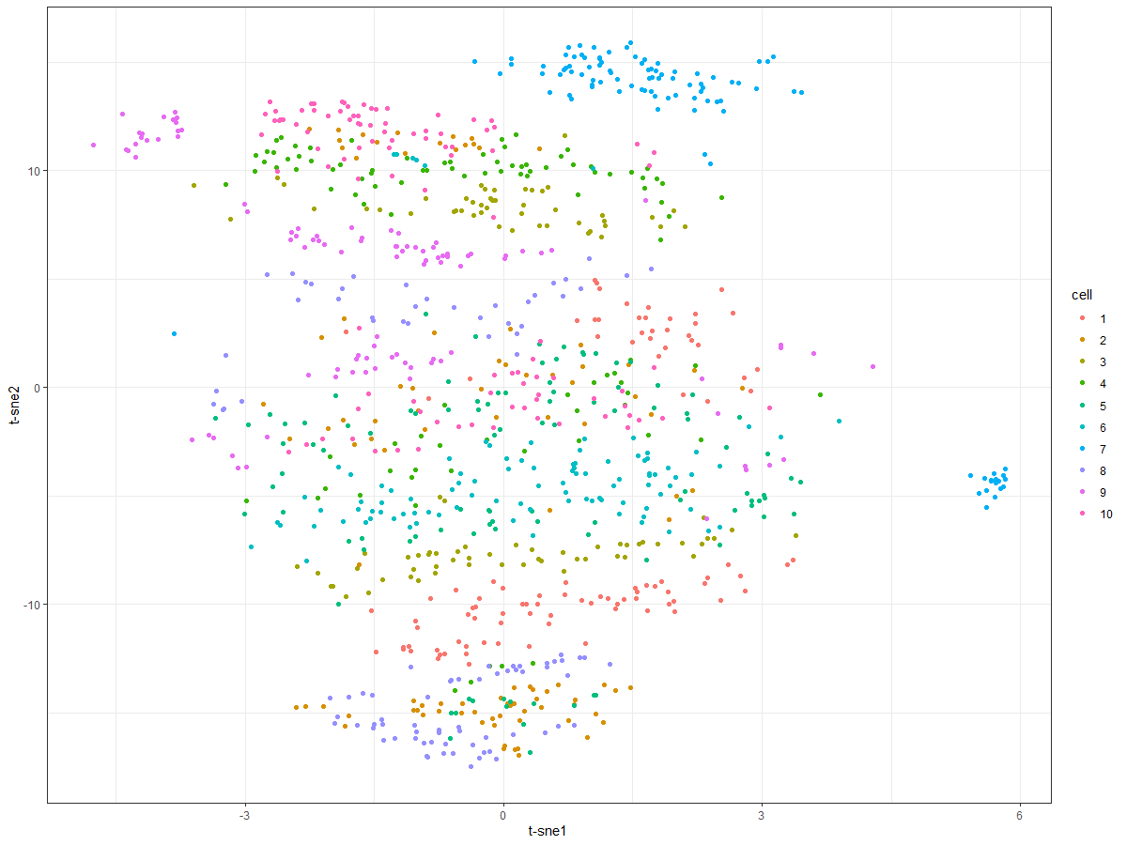
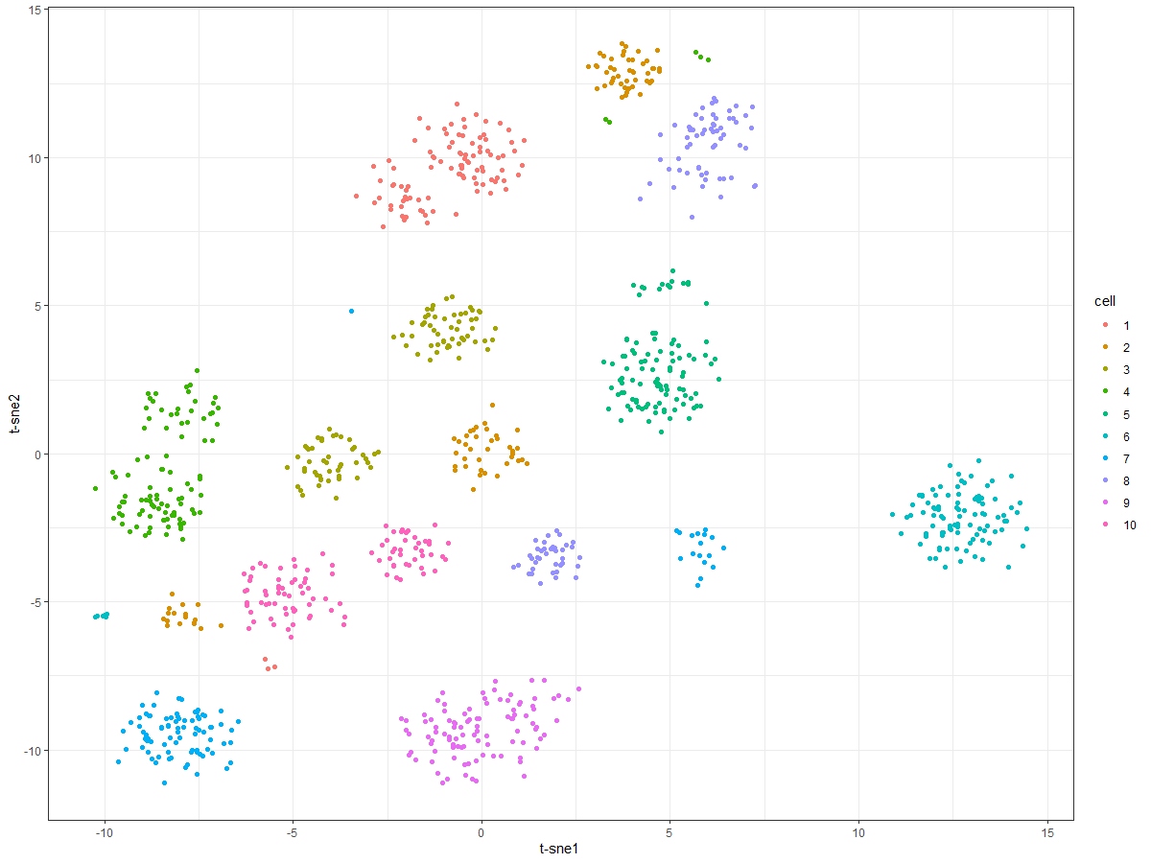
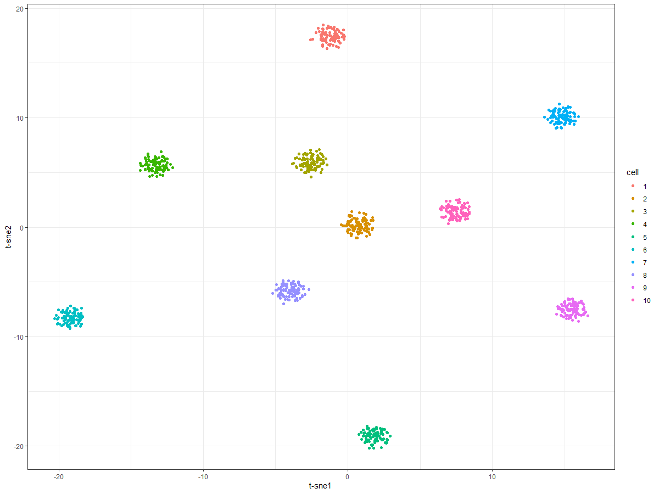
Ranking transformation: batch effect correction
uncorrected
combat
Rank the genes within a sample according to their count sizes.
 | Sample1 (count)
gene1 | 10
gene2 | 5
gene3 | 20
 | Sample1 (rank)
gene1 | 2
gene2 | 1
gene3 | 3
 | Sample1 (scale)
gene1 | 0.66
gene2 | 0.33
gene3 | 1
limma with voom
ranking
Step1: ranking
Step2: scaling (/n)
We found that ranking transformation can correct batch effect as long as batch effect does not change the relative expression level of the gene

Slide 7
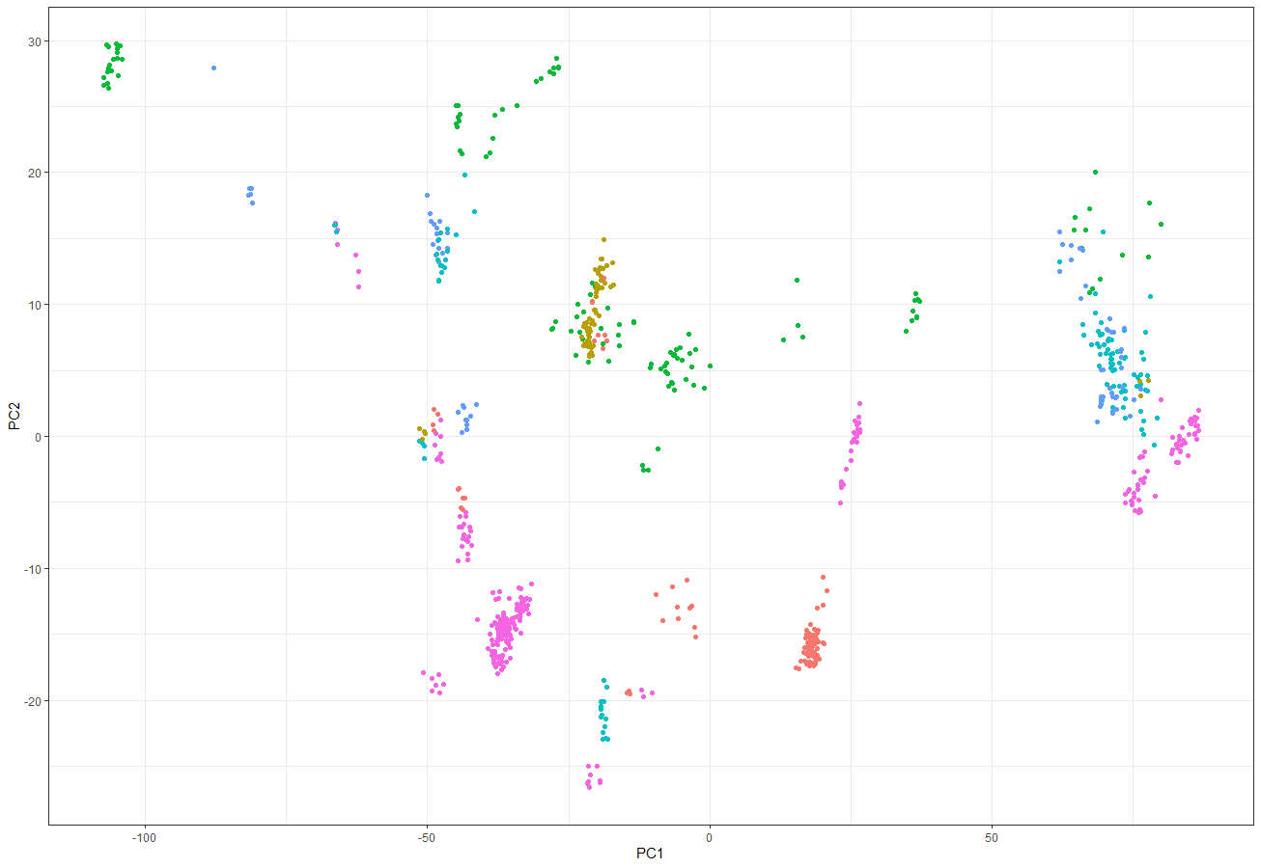
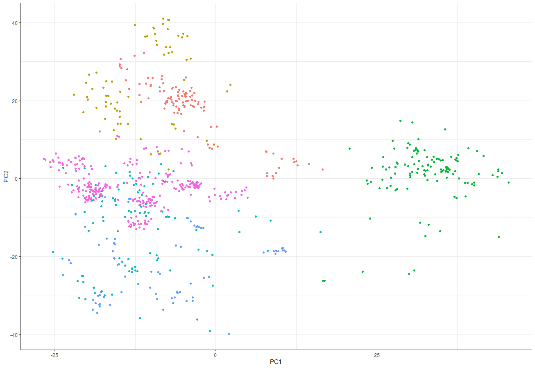
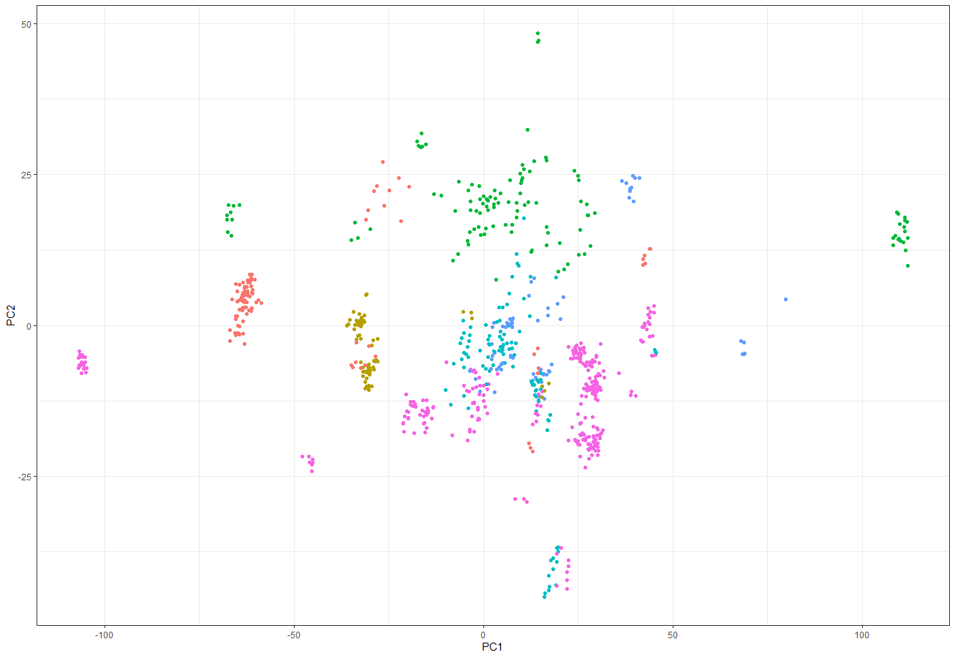
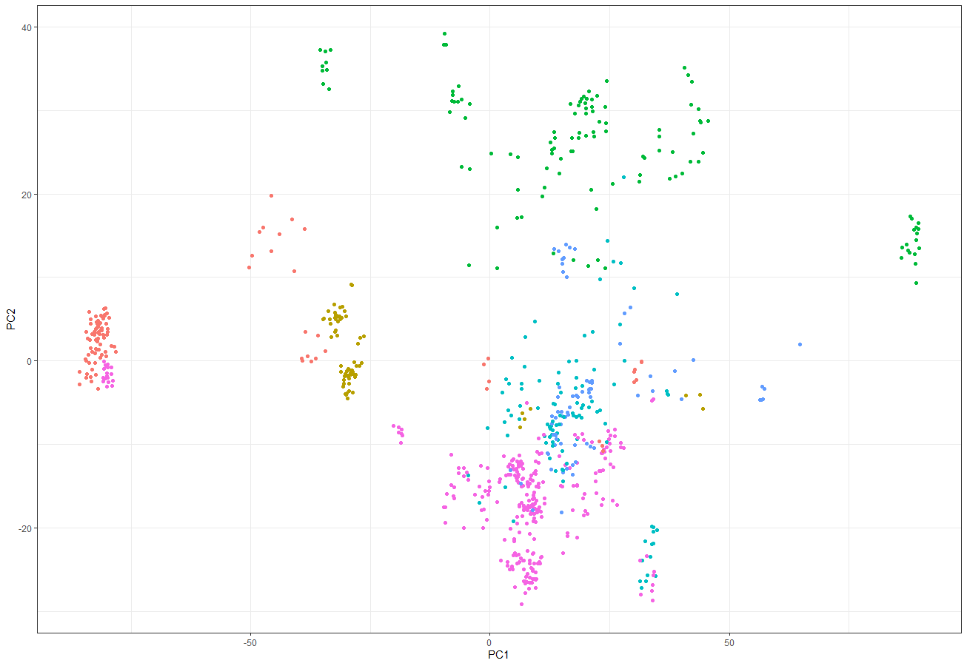
Ranking transformation on iMac
uncorrected
ranking
Dendric cell
hematopoietic multipotent progenitor
monocyte
CD1c+ dendric cell
Advantage of ranking transformation:
Non-parametric
no need to specify batch source
Can correct:
non-linear, interactive batch effect, unequal library sizes.
Doesn’t require balanced study design:
microglia
macrophage
limma
combat

Slide 8
Find D EGs (signature genes) with p-values
Linear regression analyses are normally used for finding DEGs, but they assume data to be normally distributed and have equal variance across samples.
My project was to test whether the data is normally distributed. If not, how to find the DEGs?

Slide 9
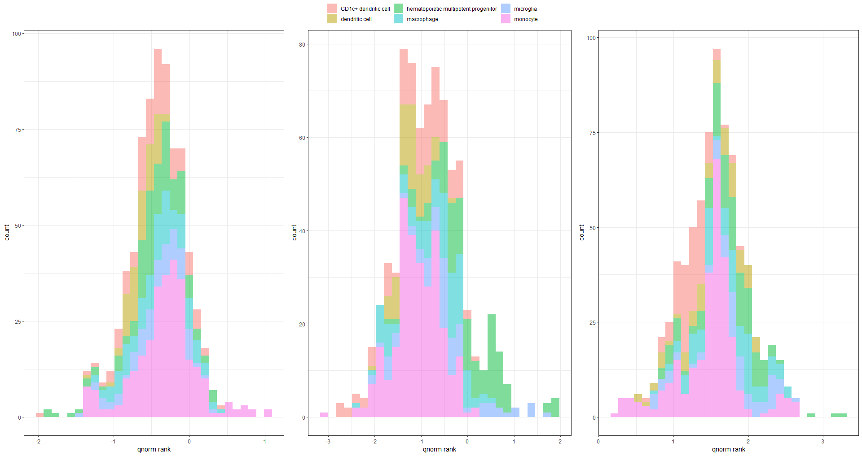
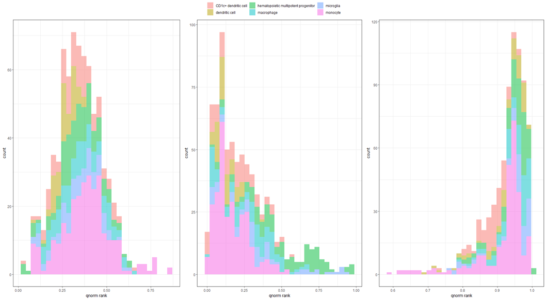
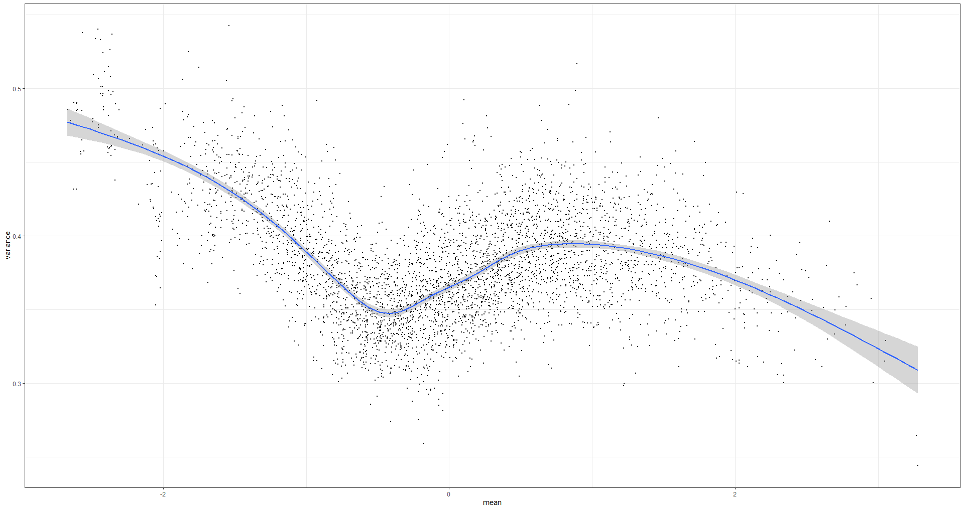
Data structure of ranking data and Probit transformation
Currently, statistical test can be done on iMac is limited. (no linear model!)
1. Ranking data is range from (0,1) and skewed
2. Unequal variances after probit transformation
Solution: Probit transformation with probit function
Solution: weighted least square regression

Slide 10
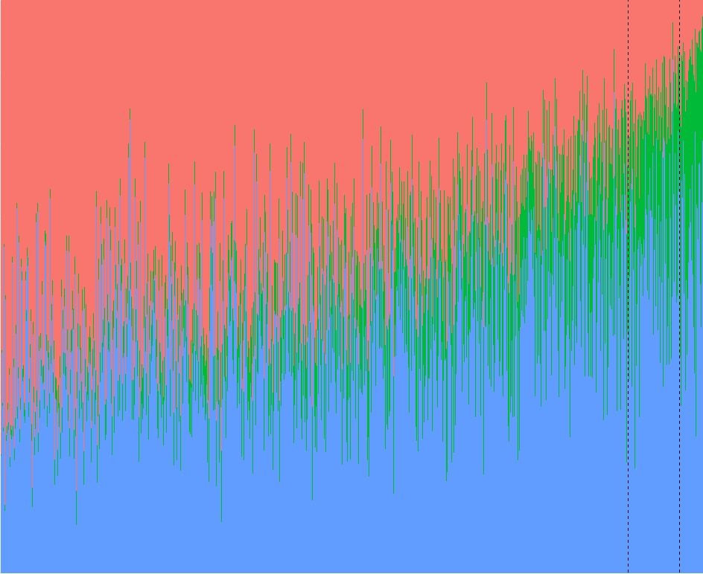

Result
We want to find genes that are: differentially expressed, but with low platform dependency.
Proportion of variation explained by batches
Proportion of variation explained by cell types
After Probit transformation
Genes are ordered according to: $\frac{Class Variance}{Platform Variance}$ ( )
Model:
Function:
Variance Partition (from Varpart package)
Unexplained variation
Genes ordered according to variance ratio

Slide 11
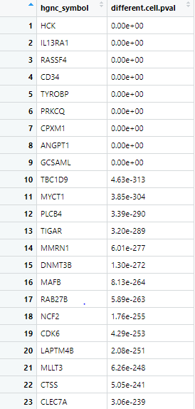
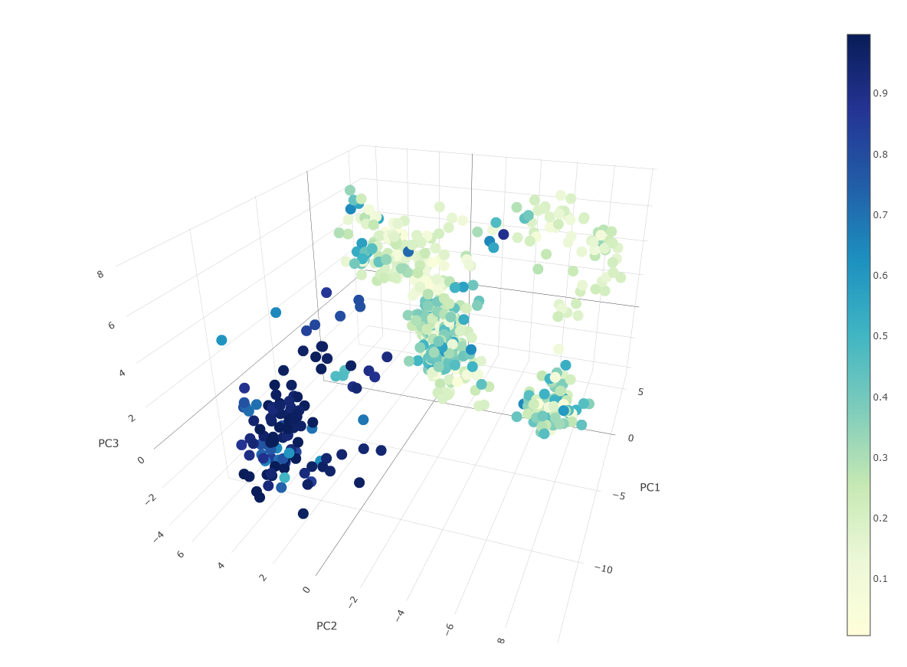
DEGs with p-values can be calculated
CD34: Hematopoietic Progenitor Cell Antigen CD34
Signature genes for
Hematopoietic Progenitor Cell (HPC)
(Likelihood ratio test and Wald test)
Hematopoietic Progenitor Cell

Slide 12
Conclusion
1. Ranking transformation can correct the batch effects of heterogenous data.
2. Ranking data need to be transformed again with Probit function to fit a linear model.
3. We can characterize the significance of the genes.
4. Our signature gene searching is successful.
Thank you to my supervisors:
Kim-Anh le Cao, Jarny Choi, Paul Angel for guiding me through the work, and to all the lab members of Lê Cao lab for helping preparing the presentation

Slide 13
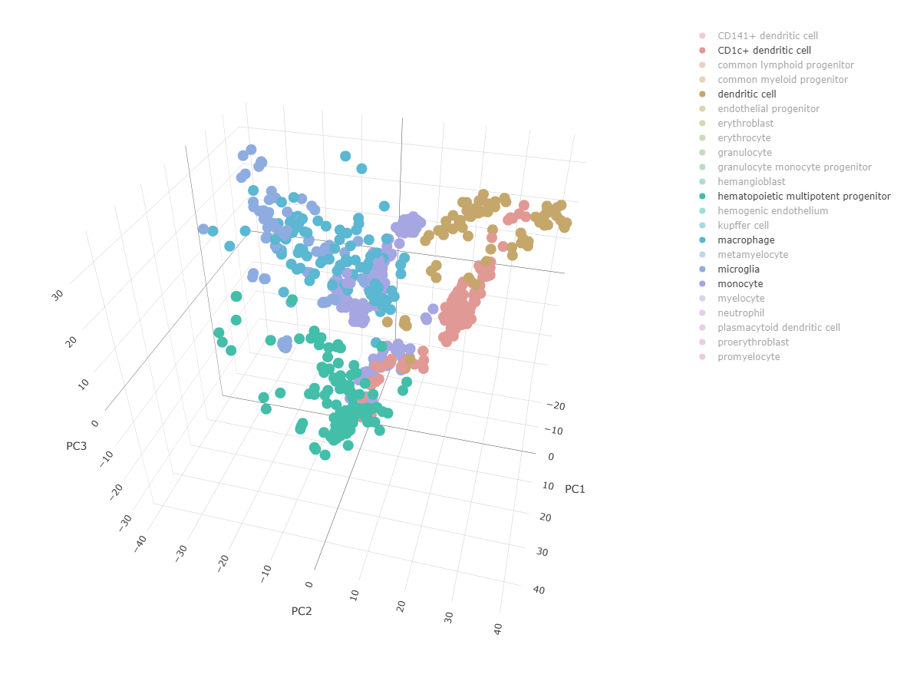
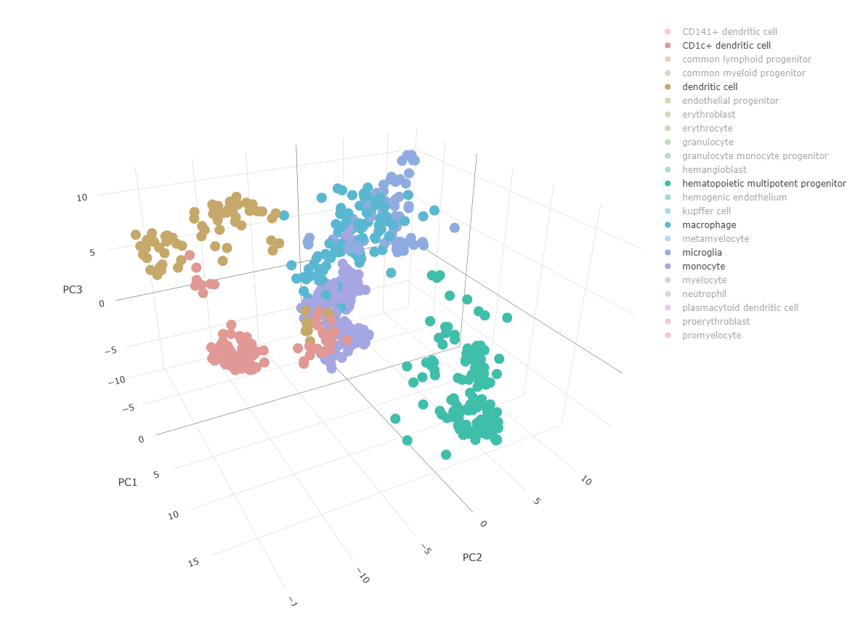
Questions! ☺
Original iMac: PCA on 3607 genes (ranking data)
Probit and LMM: first 100 signature genes
macrophage
microglia
Dendric cell
CD1c+ dendric cell
monocyte
hematopoietic multipotent progenitor

